Slide 1
Online Voting Management System
Submitted by:
Name: Kaspia Tabbassom
ID: UG02-47-18-046
Department of Computer Science and Engineering
State University of Bangladesh(SUB) Dhaka, Bangladesh
Submitted to :
Khan MD.Hasib
Lecturer,Depertment of SUB

Slide 2
Outline
Introduction
Index terms
Requirements for the project
Project objective
Overview
Literature review
Proposed methodology
Features

Slide 3
Introduction
Online Voting System is the computerized voting system introduced. It enables the voters to vote through computers and view the result in web browser. Online Voting are simple, attractive and easy to use. It reduces manual efforts and bulk of information can be handled easily. The risk of error in vote-tallying can also be largely eliminated. In this proposed system, the Internet is changing citizen expectations around the speed and convenience with which all government services and elections should be delivered. Since 2004, when Elections BC introduced North America’s first fully integrated online voter registration service, British Columbians have also been using the Internet to register to vote. It is natural that citizens are asking when they will be able to vote online, especially given that banking and other transactions requiring security to protect personal information are now routinely performed in the virtual world.

Slide 4
Index terms
E-voting = Electronic voting
HTML=Hyper Text Markup Language
CSS=Cascading Style Sheet
MySQL=Structured Query Language

Slide 5
Requirements for the project
Windows 7/ 8.0/10 Versions
Visual Studio Code
Notepad,Notepad++
Xampp -7.3.29, 7.4.21 & 8.0.8. Versions

Slide 6
Project objective
The main objective of this work is to develop an interactive voting system application with which users can participate using their information stored prior in database while creating the voter ID and the information need to be updated.

Slide 7
Literature review
Use of online voting has the capability to reduce or remove unwanted human errors. IT is reliable, scalable that it can be expanded as per need. Online voting system does not concern with it geographical location of the voters. Type of voting system till now has been implemented as: Paper Ballot Voting System - It includes casting the vote using the paper and the stamp. Each voter uses one ballot, and ballots are not shared. The voter casts his/her vote in a box at the polling station. Disadvantage is Time Consuming, Booth Capture, Low Tally Speed, etc. therefore it is not successful at large scale. Electronic voting machine – It is a type of voting system which uses electronic machine that would allow voters to broadcast their secret vote ballot to election officials over the internet. Due to big cost, high power, vulnerable in security, etc. has reduce its usage.

Slide 8
Proposed methodology
This Electronic voting system is very useful one in election. E-Voting System is a digital electronic system that user data is collected in digital manner and processed securely. Security is the important factor in this system. Every voter should have a personal identification number. This number will be automatically checked along with the ID stored on the database.

Slide 9
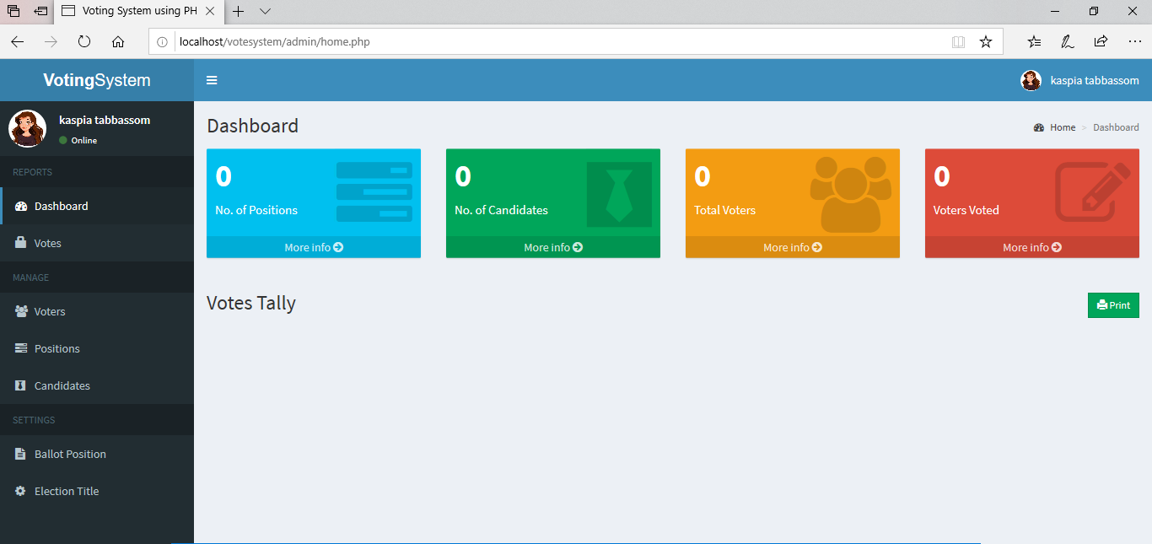
Project Overview

Slide 10
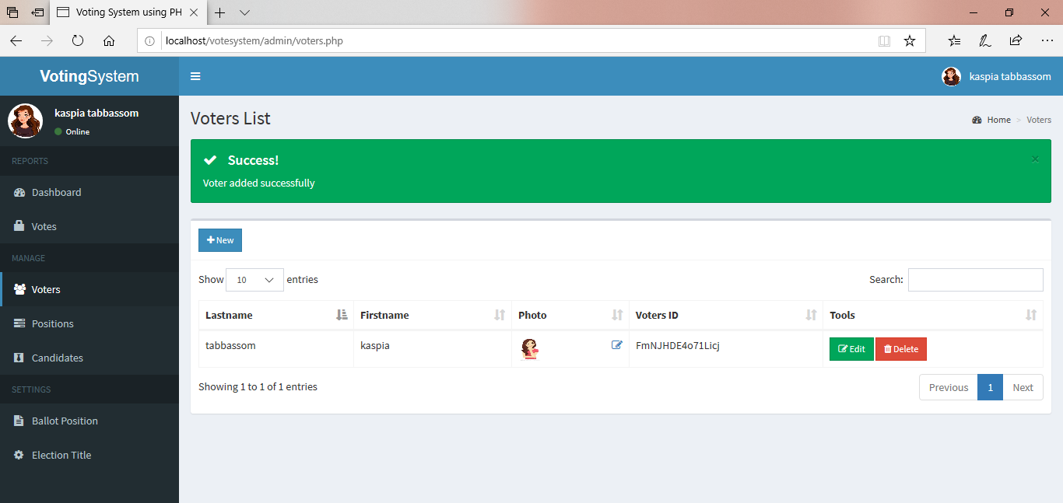
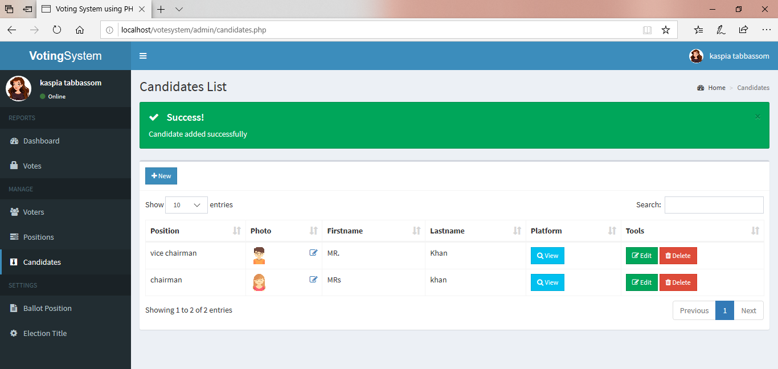
Project overview

Slide 11
Features
1 .Online voting systems in real time .
2. For this project HTML, CSS and PHP have been used .
3. Online voting has many languages for all types of people.

Slide 12
Conclusion and future work
In this report an analysis of existing e-voting schemes along with their scopes and limitations has been discussed. Although e-voting scheme proposed in fulfills all the essential requirements of voting, a further investigation over there is a demand of secure e-voting protocol. However the use of insecure internet, incorrect implementations and some other non-negligible flaws are the threads to establish the acceptance of e-voting. If the secure implementation of e-voting schemes can be ensured, people will be benefited extremely by this popular social application of cryptography.

Slide 13
Acknowledgement
I would like to thank my honourable Khan Md.Hasib Sir for his time,generosity and critical insights into this project.

Slide 14


